Slide 1
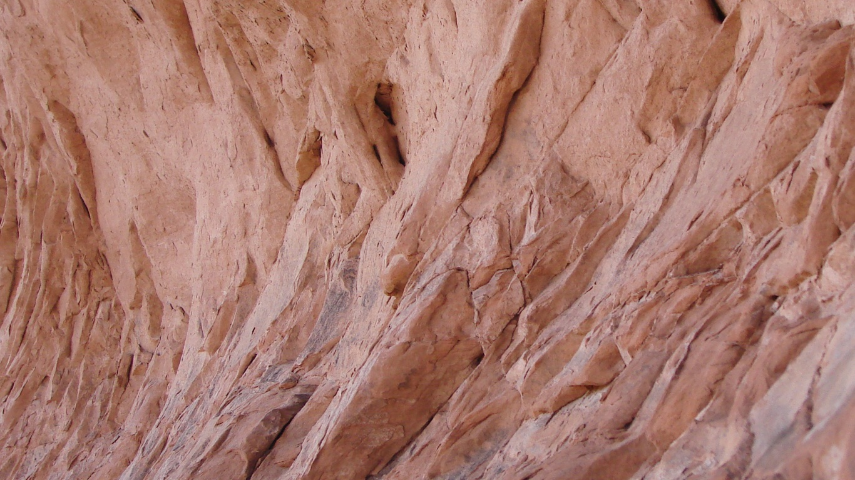
Microphone suppression of air-blast noise on geophones
Nathan Babcock and Robert R. Stewart
Department of Earth and Atmospheric Sciences
University of Houston
Notes:
This is the PPT I used during my thesis proposal. I have added notes in the comment section to clarify and explain the slides.

Slide 2
OUTLINE
What is air-noise?
  Near surface model
  Ground-to-air conversion
How does air-noise affect a geophone?
  Distance dependency
  Angular dependency
  Frequency dependency
Filter methods
  Previous work
  Real-time filter
  Post-processing filter
  Filter results on lab data
Conclusions

Slide 3
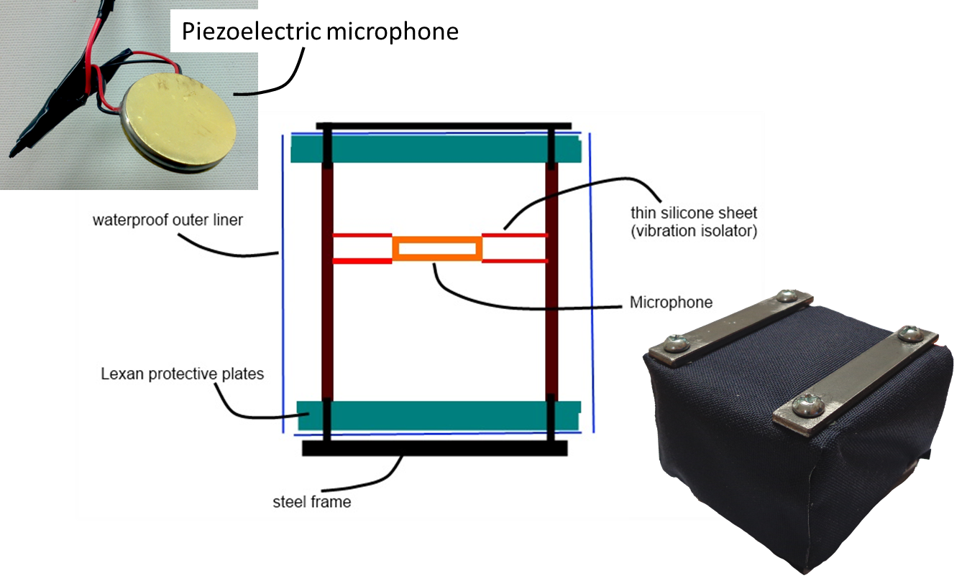
Hardware design
(Shields, 2005)

Slide 4
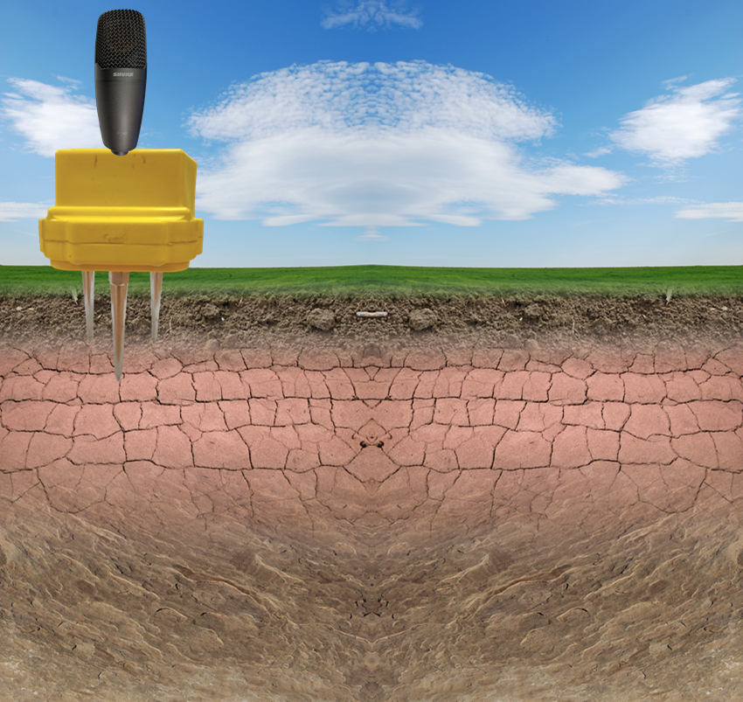

Air-noise: foundation
Near surface model
Atmosphere
($Z≠0$)
Topsoil (weathering layer)
(poroelastic)
Unconsolidated sediment
(poroelastic)
Compacted sediment
(effectively non-porous)

Slide 5
Ground-to-air conversion
Direct travel

Slide 6
Ground-to-air conversion
Direct travel
Direct transmission
(Bass et al., 1980)
(Sabatier et al., 1986a)

Slide 7
Ground-to-air conversion
Direct travel
Direct transmission
Ground roll conversion
(Press and Ewing, 1951)

Slide 8
Ground-to-air conversion
Direct travel
Direct transmission
Ground roll conversion
Slow wave conversion
(Sabatier et al., 1986b)

Slide 9
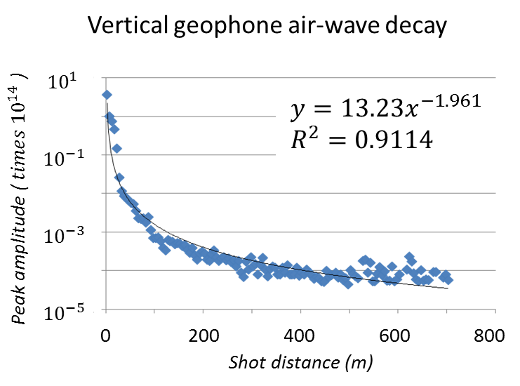
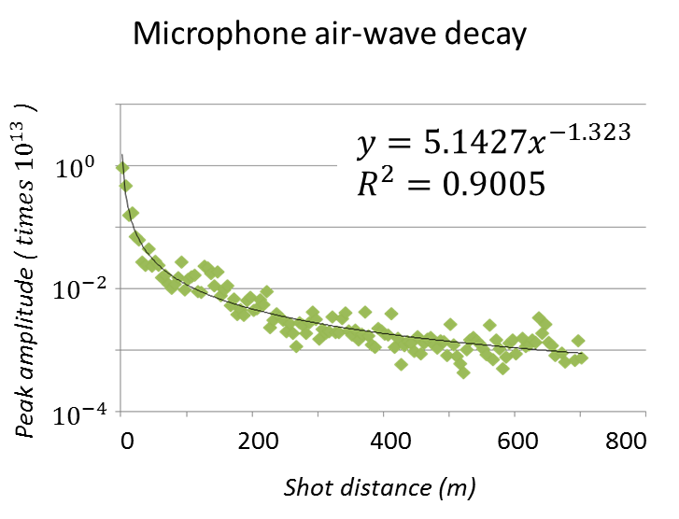
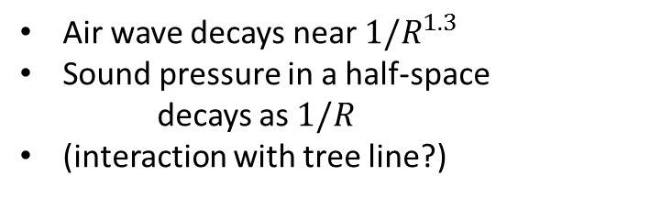
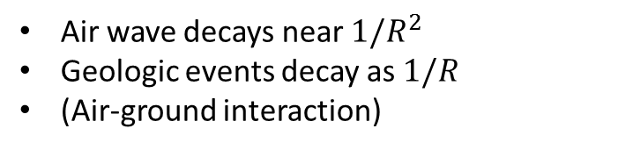
Air-noise and geophones
Distance relationship
Amplitude
Air wave decays near $1/R^{2}$
Geologic events decay as $1/R$
(Air-ground interaction)
Air wave decays near $1/R^{1.3}$
Sound pressure in a half-space
decays as $1/R$
(interaction with tree line?)

Slide 10
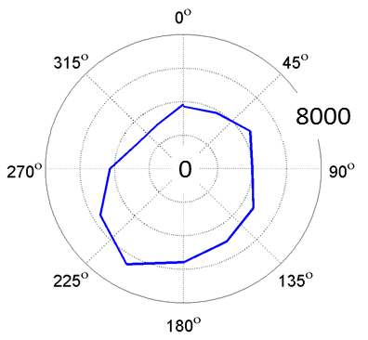
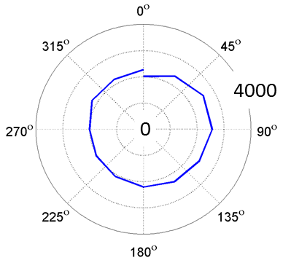
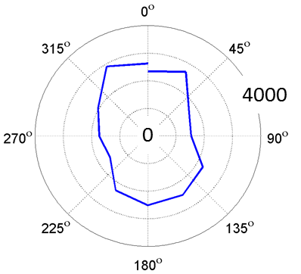
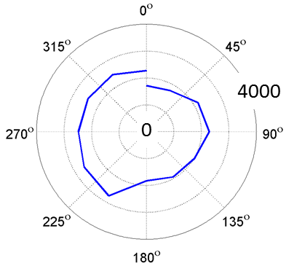
Air-noise and geophones
Angular relationship
Amplitude
Vertical component
RMS response
Microphone
RMS response
Sensitive to ~210°
Omnidirectional
Inline component
RMS response
Crossline component
RMS response
Sensitive to ~0° & 180 °
Sensitive to ~270°

Slide 11
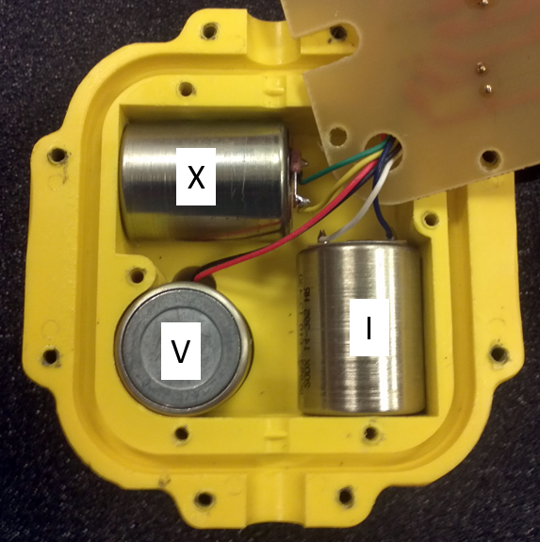
Air-noise and geophones
Angular relationship
Amplitude
Vertical component
RMS response
Microphone
RMS response
Sensitive to ~210°
Omnidirectional
Inline component
RMS response
Crossline component
RMS response
Sensitive to ~0° & 180 °
Sensitive to ~270°

Slide 12
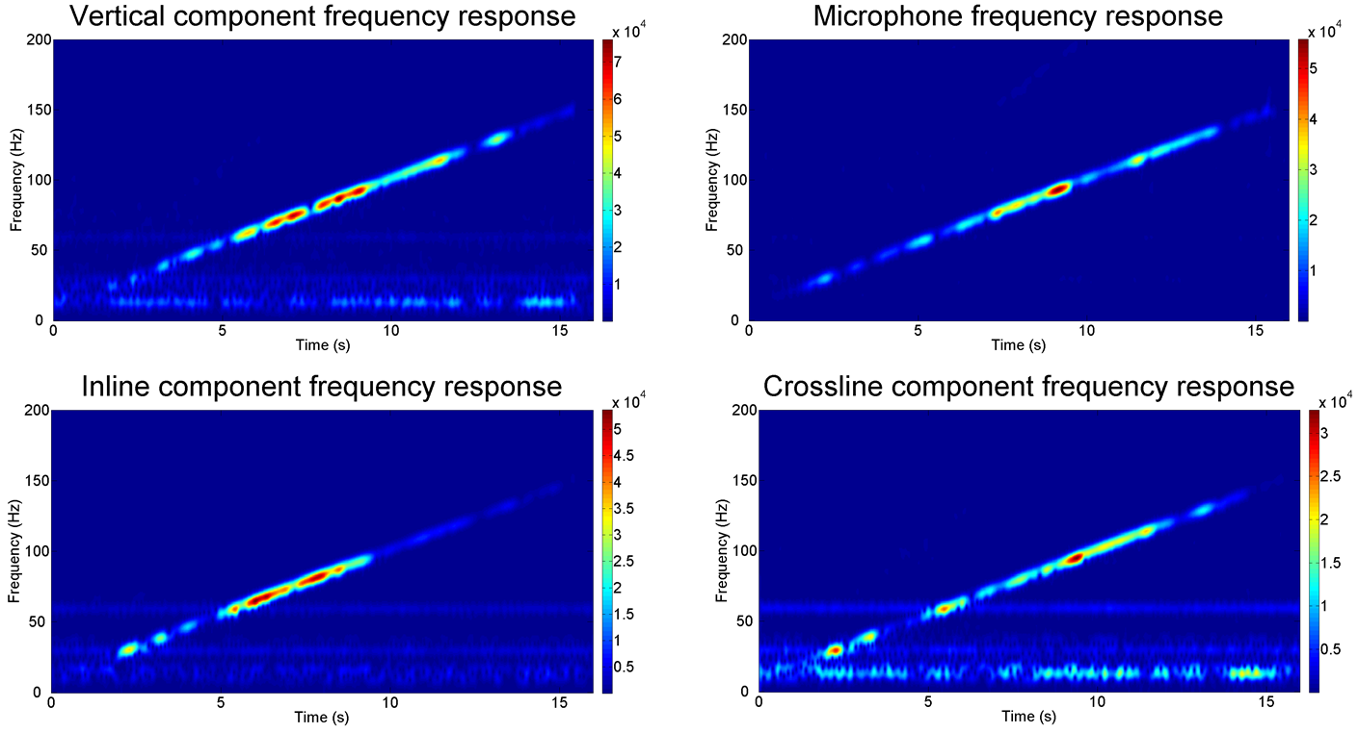
Air-noise and geophones
Frequency relationship
Amplitude

Slide 13
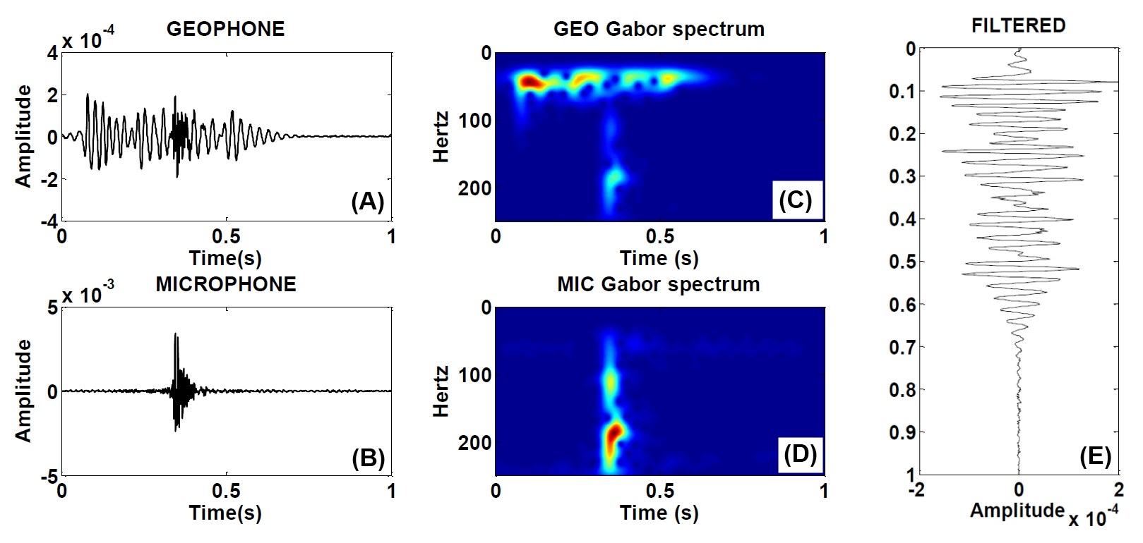
  Filter methods: previous work
Filtering in the time-frequency domain (Gabor filter)
Create null mask from microphone record
Multiply geophone record by null mask
(After Alcudia, 2009)
Notes:
The time-frequency method of noise cancellation is the second method previously used. In this scheme both records (left top and bottom) are transformed using the Gabor transform. A null mask is made from the microphone spectrum (center bottom). The mask creates a 0 wherever the microphone spectrum exceeds a certain value and remains a 1 where it remains low. This effectively highlights the air noise with a 0 mask. This mask is multiplied by the geophone spectrum (center top) to remove the air noise. The spectrum is inverted back to the time domain to produce a filtered geophone record (right).
This method is effective, but has only been applied as a post processing step. It seems unfeasible to perform this type of filtering in real time at the geophone.

Slide 14
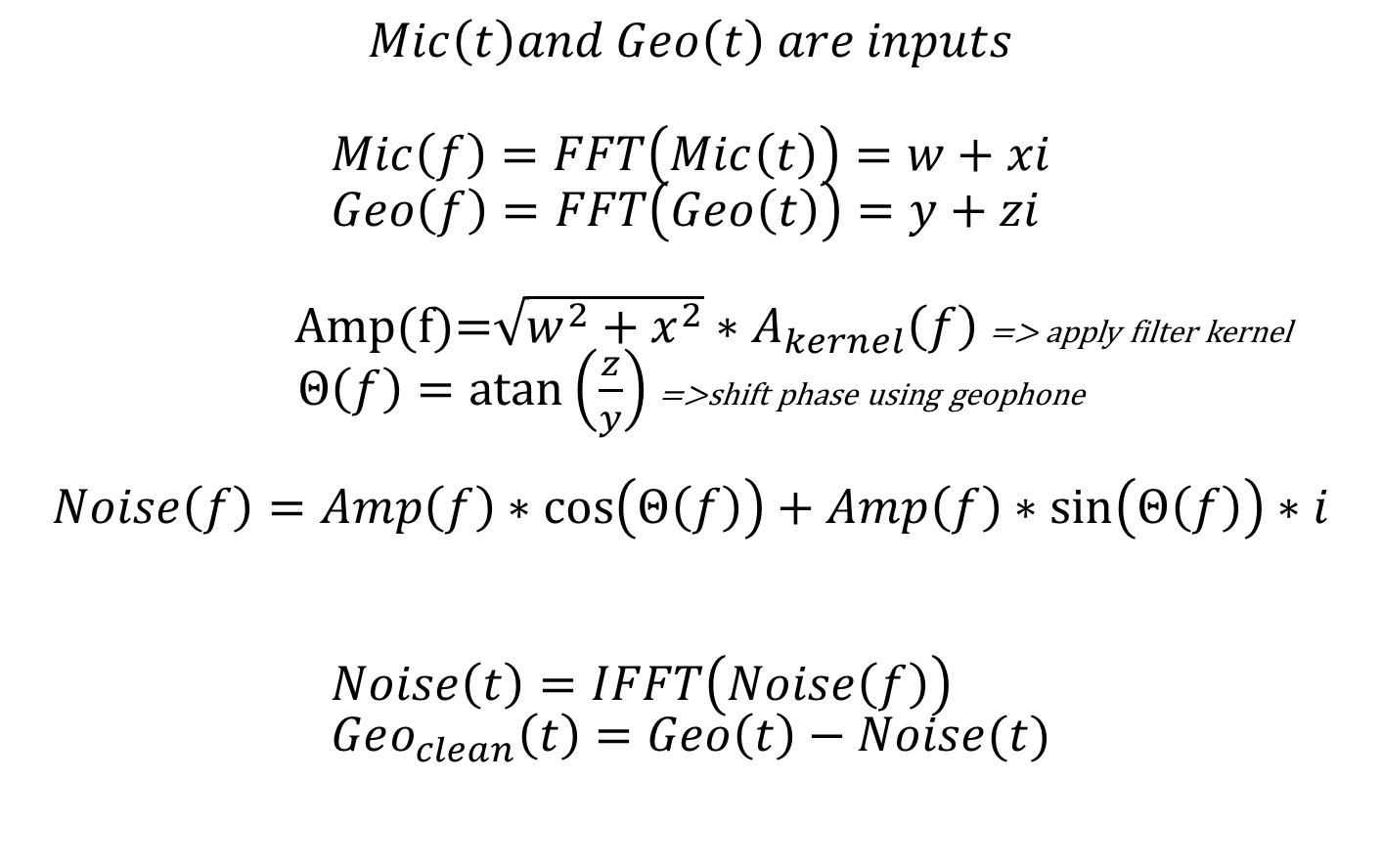
Filter method: real-time

Slide 15
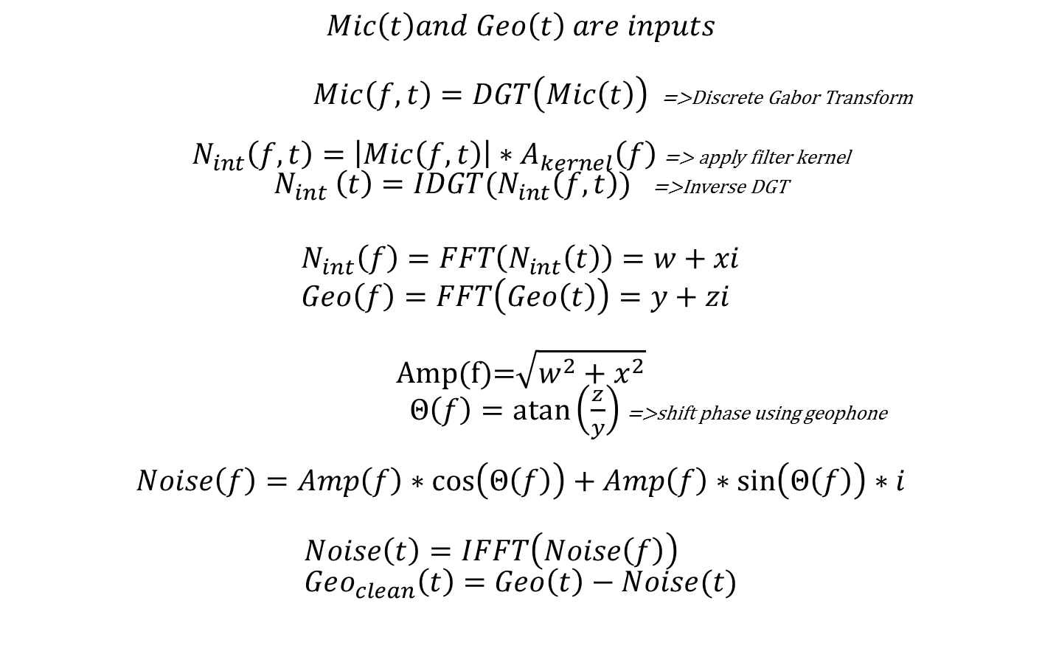
Filter method: post-processing

Slide 16
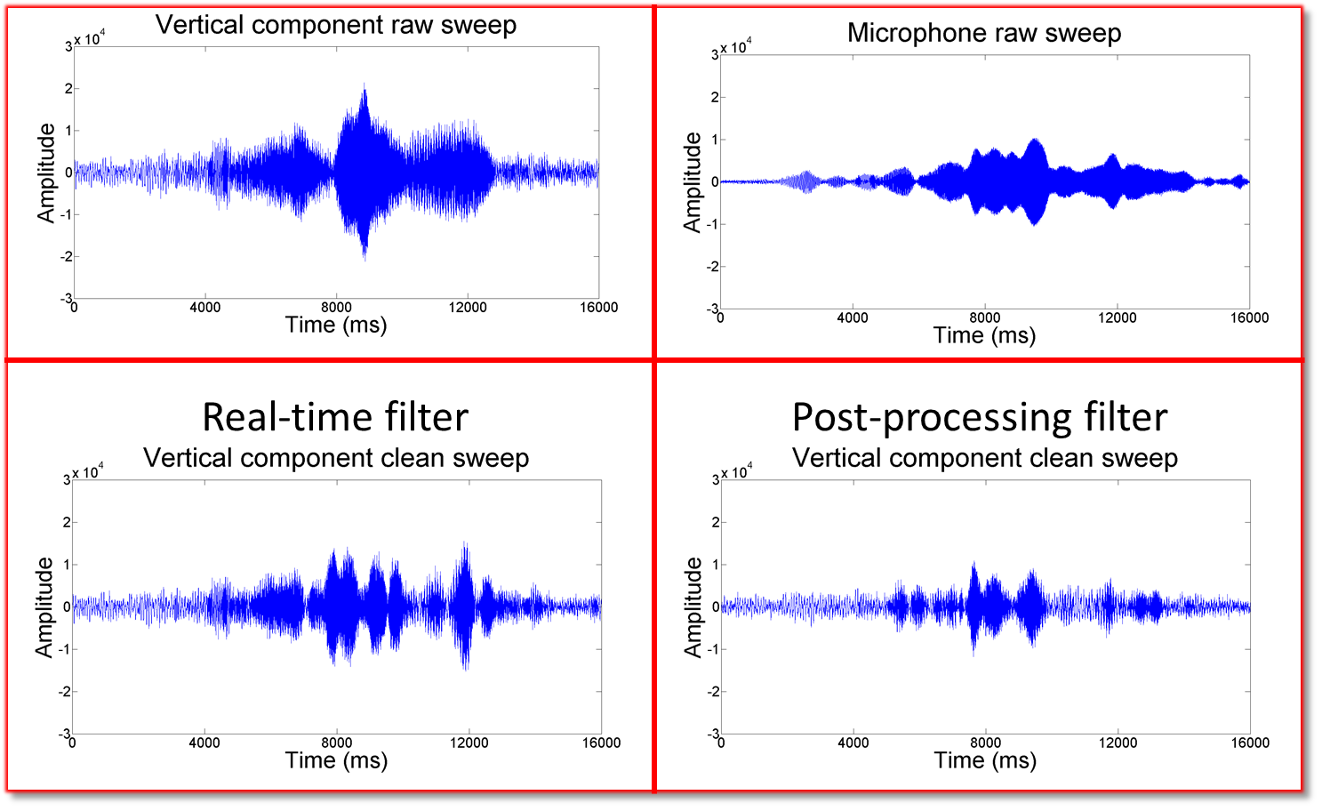
Filter methods: results

Slide 17
Conclusions
Air-noise filters must handle variability in noise source:
  Distance
  Angle
  Frequency
The post-processing filter is more effective than the
real-time filter
  Increased computing power and processing time

Slide 18
References
Alcudia, A. D., 2009, Microphone and geophone data analysis for noise characterization and seismic signal enhancement: M.Sc thesis, University of Calgary.
Bass, H. E, L. N. Bolen, D. Cress, J. Lundien, and M. Flohr, 1980, Coupling of airborne sound into the earth: Frequency dependence: The Journal of the Acoustical Society of America, 67, 1502.
Press, F., and M. Ewing, 1951, Ground roll coupling to atmospheric compressional waves: Geophysics, 16, 416.
Sabatier, J. M., H. E. Bass, and L. N. Bolen, 1986a, The interaction of airborne sound with the porous ground: The theoretical formulation: The Journal of the Acoustical Society of America, 79, 1345.
Sabatier, J. M., H. E. Bass, and L. N. Bolen, 1986b, Acoustically induced seismic waves: The Journal of the Acoustical Society of America, 80, 646.
Shields, D. F., 2005, Low-frequency wind noise correlation in microphone arrays: The Journal of the Acoustical Society of America, 117, 3489.
Photo credits: Alfred Borchard, W. Beate, István Benedek

